Slide 1


Go-Session-2
---------------------
Package in Go Programming
By Shadab Akhtar

Slide 2
--------------------------------------------------------------------------------------------------
Module Introduction
--------------------------------------------------------------------------------------------------
In this module, we will cover
Use of packages in programming
How to import a package ?
Key Differences between “os” and “bufio”

Slide 3
------------------------------------------------------------------------------------------------
Packages in Go programming language
------------------------------------------------------------------------------------------------
There are several essential packages that you should be familiar with to get started with writing Go programs. Go has a rich standard library that provides many built-in packages for common tasks.
Here are some fundamental packages to start with:
fmt: The fmt package provides functions for formatted input and output. You'll frequently use fmt.Println() and fmt.Printf() for printing to the console.
math: The math package offers mathematical functions and constants for basic arithmetic operations, trigonometry, and more.
io: The io package provides interfaces and utilities for input/output operations. It's used for reading and writing data streams.
os: The os package gives you access to functions related to the operating system, such as file operations, environment variables, and command-line arguments.

Slide 4
------------------------------------------------------------------------------------------------
Packages in Go programming language
------------------------------------------------------------------------------------------------
bufio: The bufio package provides buffered I/O, which can improve the performance of reading and writing data from files and network connections.
strings: The strings package offers functions for manipulating strings, including substring searches, replacements, and conversions.
strconv: The strconv package is used for converting between strings and numeric types like integers and floats.
time: The time package provides functionality for working with dates, times, and durations.
net/http: If you're interested in web development, the net/http package is crucial for building HTTP servers and clients.
encoding/json: This package allows you to encode and decode JSON data, which is commonly used in web applications and APIs.
database/sql: If you're working with databases, the database/sql package provides a generic interface for interacting with SQL databases, and you can use database-specific drivers with it.

Slide 5
------------------------------------------------------------------------------------------------
Packages in Go programming language
------------------------------------------------------------------------------------------------
log: The log package provides simple logging capabilities for your Go programs.
These packages are part of the Go standard library, so you don't need to install them separately. To use a package, you typically import it at the beginning of your Go source code file, like so:
import (
"fmt"
"net/http"
// Import other packages as needed
)

Slide 6
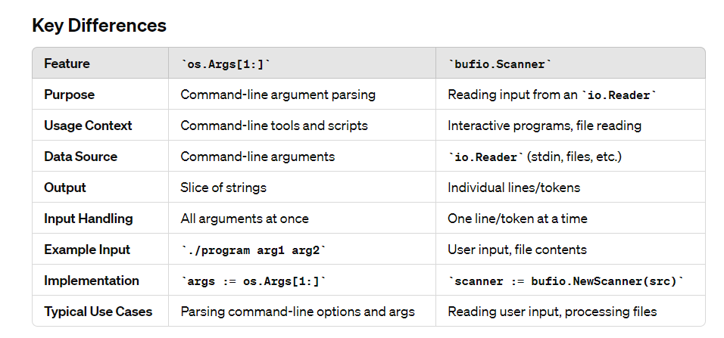

Slide 7
--------------------------------------------------------------------------------------------------
Module Summary
--------------------------------------------------------------------------------------------------
In this module, we have covered
-------------------------------
Use of packages in programming
How to import a package ?
Key Differences between “os” and “bufio”

Slide 8


Slide 9


